Slide 1
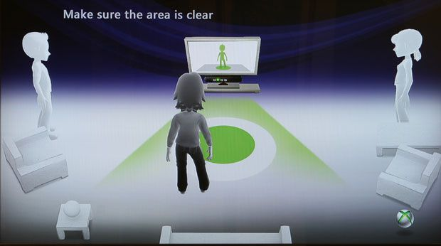
Virtual Gym Trainer

Slide 2
Introduction :
In existing gym or workout applications ,the exercise in explained using description or by animated videos. These methods may be helpful for guiding the user about the techniques but these applications merely serve the purpose of guide-book for the user. And for proper workout there is a need of a trainer. So that the performer/user performs exercise in the supervision of trainer and the flaws in the exercise could be corrected.
To cover the purpose of trainer we need an interactive application like virtual gym trainer which will keep the record of real-time body postures and predict the flaws in the movement of body.

Slide 3

Problems regarding workout

Slide 4
Some of the problems regarding workout
Costly gyms and trainer
Introvert + Fitness Freak (or having no time for gym)
Using existing gym application do not provide supervision

Slide 5

Costly gym and trainer
As we know that we need a trainer for a proper workout and it is not easy to find an affordable trainer. Not everyone can pay fee for gym and trainer.

Slide 6
Introvert+Fitness freak (having no time for gym)
Many people want to maintain there fitness but for some reason they don’t go to gym either they are afraid of being judged or have no time for going out for gym

Slide 7
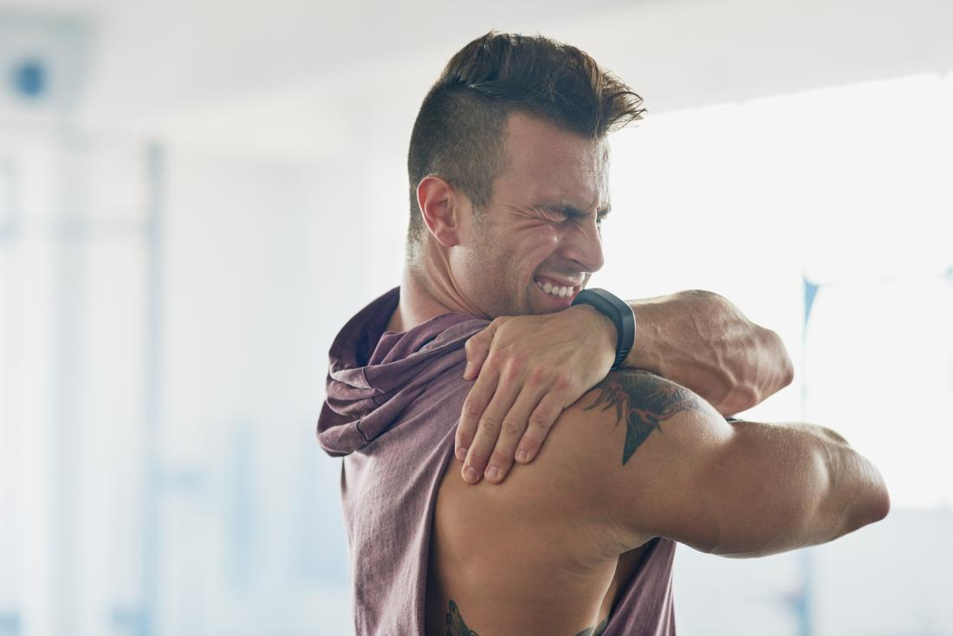
Apps without supervision
The usual workout applications do provide the guide but there is still no application available for supervision of the user, which can detect flaws in body postures. And by doing wrong techniques it will lead to many problems

Slide 8
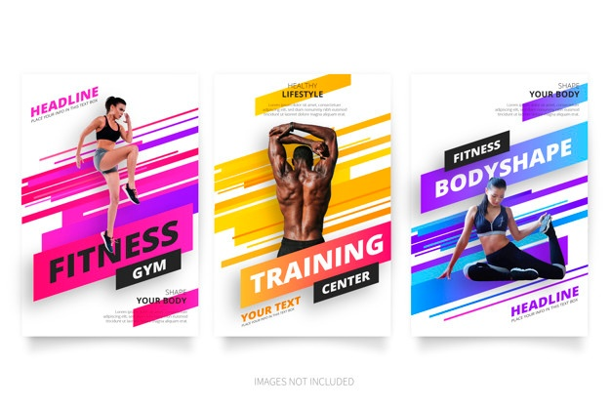
Related work:

Slide 9
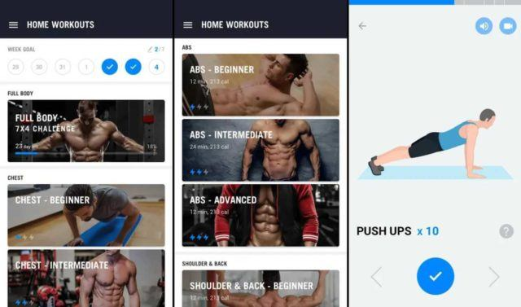
Home Workout
Routine planning by using animation but without gym equipments
METHODOLOGY: DESCRIPTION AND VISUAL EXPLANATION

Slide 10
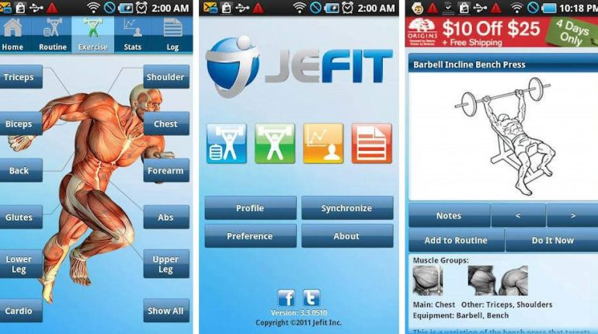
Jefit app
Routine planning by using animation
Record maintain:Set target using tracking tools
METHODOLOGY: DESCRIPTION AND VISUAL EXPLANATION

Slide 11
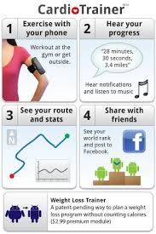
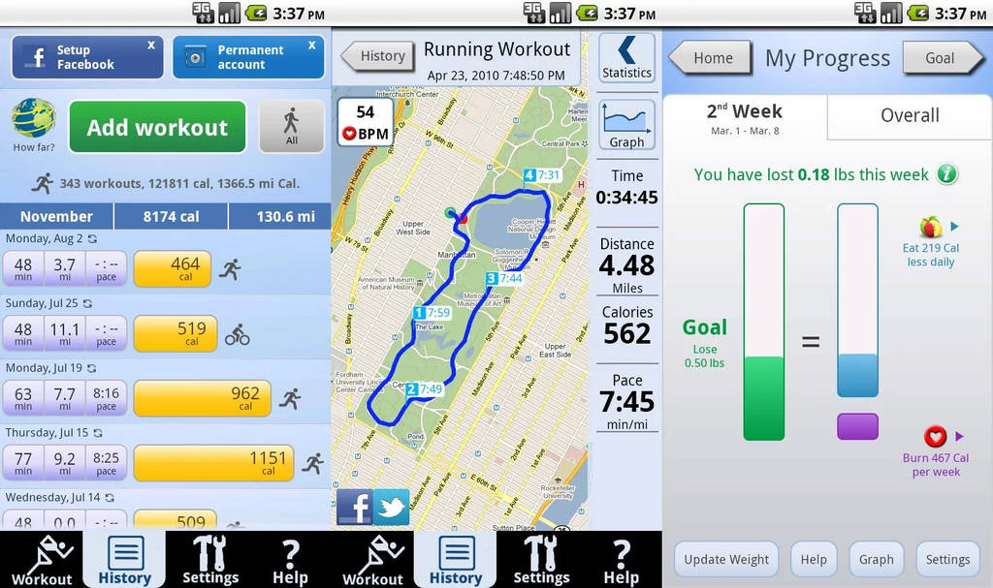
Cardio trainer:
Used for specifically jogging and walking
METHODOLOGY: GPRS system for calculating distance location tracks

Slide 12
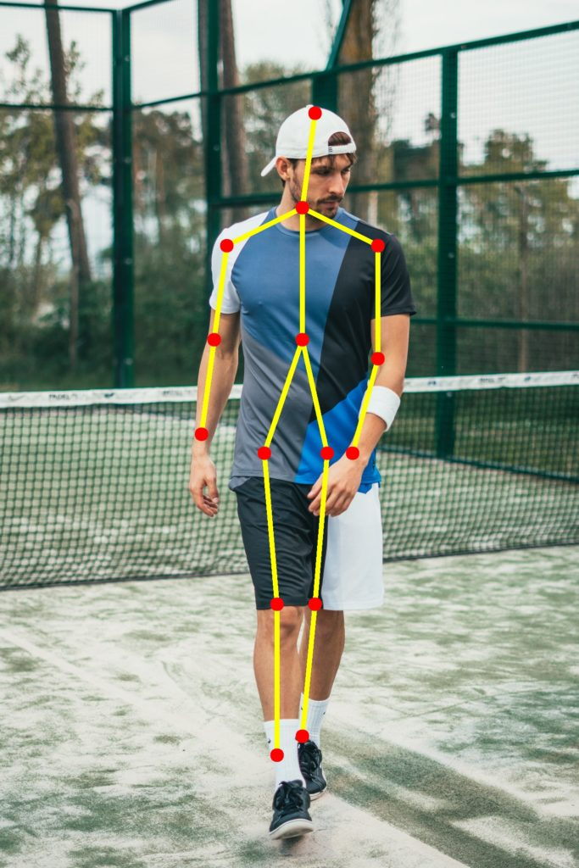
Proposed Methodology:
The main work of this application is to get video as an input at real-time to detect the body. By parsing the input we will find the body part using image processing . Then parsed data will be compared to correct data set to predict the flaws in exercise.
Web cam
Laptop(desktop)
Pc application
Image processing
Dataset.

Slide 13
Expected Work
We need to make an interactive application such that the application supervise the exercise performed by the user. To do that our application should perform the following task:
This application will get video as an input at real-time to detect the body.
Then the data will be parsed according to the related body posture.
The fetched body posture will be cross check with the correct one .In case of wrong posture ,the application will make a beep sound.
After comparing the real time info with stored data set, application will predict the correct position needed for the exercise.

Slide 14
Conclusion
By using this application we can cover the following goals:
This app will cut down the cost of gym and trainer.
This app could be helpful for the introverts to practice exercise at home.
This app can be helpful for finding flaws in the exercise being performed by the user.

